Slide 1
Unit-3
Cont…

Slide 2
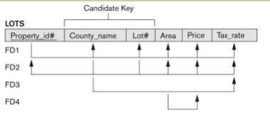
Example for Normalization
The above relation describes parcels of land for sale in various county of a state. Suppose there are 2 candidate keys as:
1. Property_ID
2. County_Name and Lot_No

Slide 3
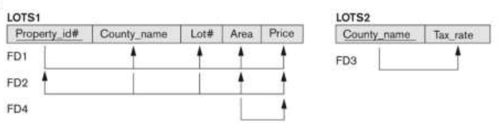
2 NF Conversion
Remove partial functional dependency
County_Name -> Tax_Rate

Slide 4
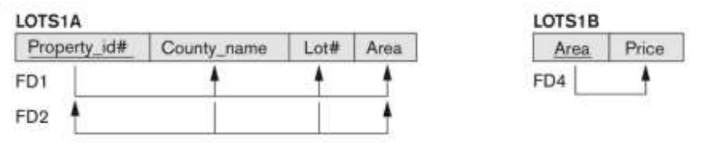
3 NF Conversion of relation LOT1
Here remove transitive dependency
Area -> Price and
Property_Id -> Area

Slide 5
BCNF – Boyce Codd Normal Form
BCNF is the advance version of 3NF. It is stricter than 3NF.
A table is in BCNF if every functional dependency X → Y,
X is the super key of the table.
For BCNF, the table should be in 3NF, and for every FD, LHS is super key.
General definition of 3NF is:
For any FD X->Y:
X is a super Key of R OR
Y is a Prime Attribute of R

Slide 6
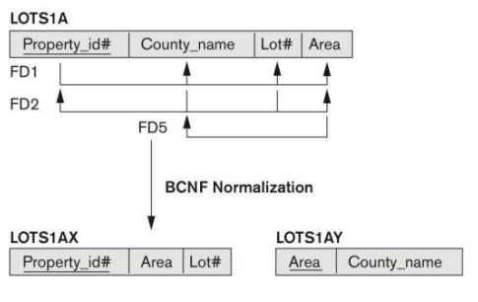
BCNF
In the above relation LOTs1A if we assume that the Lot size/ area is fix per county and they are from 2 county only
So in that case we can add one more FD i.e. Area -> County_Name
So, according to 3NF this is allowed FD as: Area is not a super key according to rule (i) but as rule (ii) says County_Name is a prime attribute.
But according to BCNF only one condition is allowed for FD is that the determinant must be a super key. So, Need to convert the relation LOTs1A into BCNF as shown below:

Slide 7


BCNF Example
Candidate Key:
{Student,Course}
FDs:
{Student,Course} -> Instructor
Instructor -> Course
Decomposition Rule:

Slide 8
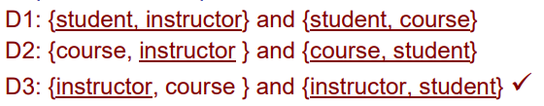
Conversion into BCNF
Out of all above 3 decomposition
Only D3 follows the decomposition rule for BCNF
So D3 is the only valid decomposition

Slide 9
R(StudentID, StudentName, CourseID, CourseName, InstructorID, InstructorName, Dept, Grade)
Examples for Normalization
Given functional dependencies (FDs)
FD1 : StudentID → StudentName
FD2 : CourseID → CourseName, InstructorID
FD3 : InstructorID → InstructorName, Dept
FD4 : {StudentID, CourseID} → Grade

Slide 10
Explanation
Key: {StudentID, CourseID}
After 2NF:
R1: Student (StudentID , StudentName)
R2: Course (CourseID, CourseName, InstructorID, InstructorName, Dept)
R3: Enrollment (StudentID, CourseID, Grade)
After 3NF:
R1 and R3 will remain as it is and remove transiti FD from R2
R2a : Instructor(InstructorID PK, InstructorName, Dept)
R2b : Course(CourseID PK, CourseName, InstructorID)

Slide 11
Examples for Normalization
R(StuID, StuName, Dept, CourseID, CourseName, Instructor, RoomNo)
StuID → StuName, Dept(Student ID uniquely identifies student info)
CourseID → CourseName, Instructor(Each course has a fixed name and instructor)
Instructor → RoomNo(An instructor is assigned a specific room for lectures)
(StuID, CourseID) → (all other attributes)
(Student enrollment in a course is uniquely identified by StuID+CourseID)

Slide 12
Decomposition
R = (StuID, StuName, Dept, CourseID, CourseName, Instructor, RoomNo) already in 1NF
Primary key = (StuID, CourseID) (composite).
In 2NF, no non-prime attribute should depend on part of composite key.
Check partial dependencies:
StuID → StuName, Dept → partial dependency (depends only on StuID). ❌
CourseID → CourseName, Instructor → partial dependency (depends only on CourseID). ❌
So 2NF decompose:
R1(StuID, StuName, Dept)
R2(CourseID, CourseName, Instructor, RoomNo)
R3(StuID, CourseID)

Slide 13
3NF
Check transitive dependencies:
In R2: CourseID → Instructor and Instructor → RoomNo → CourseID → RoomNo (transitive dependency). ❌
Decompose R2:
R2a(CourseID, CourseName, Instructor)
R2b(Instructor, RoomNo)
Now all transitive dependencies are removed.
So after 3NF decomposition:
R1(StuID, StuName, Dept)
R2a(CourseID, CourseName, Instructor)
R2b(Instructor, RoomNo)
R3(StuID, CourseID)

